Slide 1
Presentation by team signature artificial
Team members-Amit Mishra, manish kumar, Koushik chakrabarty

Slide 2
agenda
Finding the best ways to start in the field of Data Science and Machine Learning (ML) and the ways of staying strong in this field…

Slide 3

introduction
WHAT IS MACHINE LEARNING?
Machine learning (ML) is a type of artificial intelligence (AI) that allows software applications to become more accurate at predicting outcomes without being explicitly programmed to do so.

Slide 4
What is data science? Data science is the domain of study that deals with vast volumes of data using modern tools and techniques to find unseen patterns, derive meaningful information, and make business decisions. Data science uses complex machine learning algorithms to build predictive models.

Slide 5
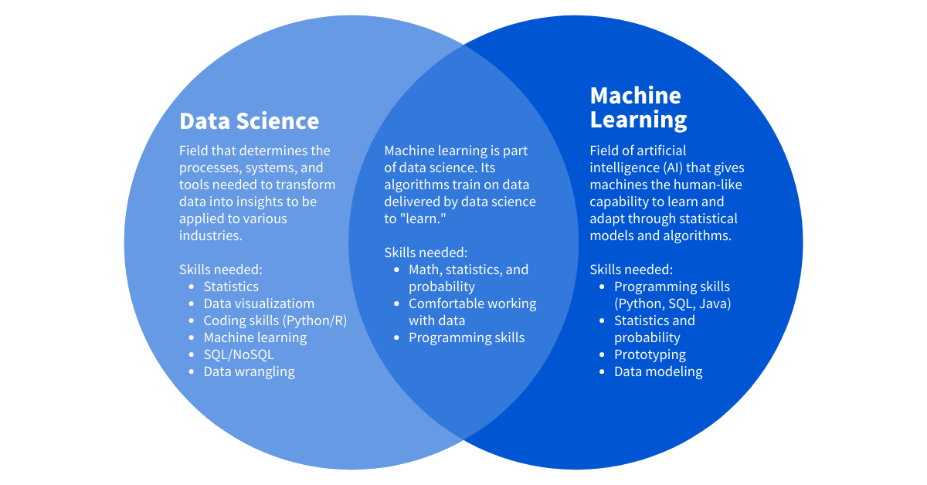
RELATION BETWEEN MACHINE LEARNING AND DATA SCIENCE

Slide 6
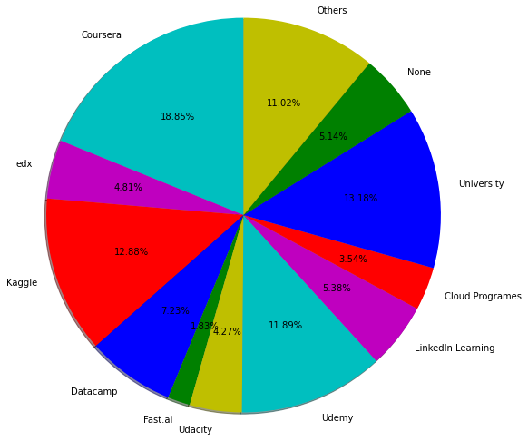
PATH TO BEGIN
Platforms to start learn with

Slide 7
From the previous given graph the most popular learning platform to begin with is COURSERA. It is very beginner friendly.
Udemy and University courses may also be prefered as seen from the graph

Slide 8
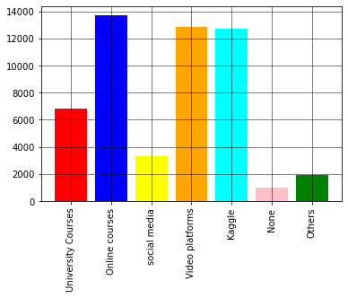
What products or platforms find to be most helpful when first started studying data science?

Slide 9
As it can be seen from the previous attached graph that the online courses are most useful tool when started studying data science.
Also video platforms like YouTube are useful to learn from different free available contents and sites like Kaggle are useful to get datasets to practice ML algorithms.

Slide 10
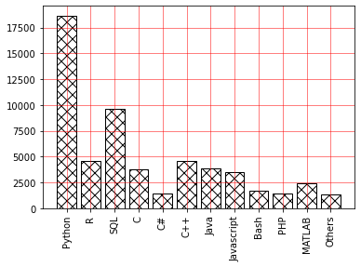
MOST PREFERRED LANGUAGE TO BEGIN WITH….

Slide 11
As seen from the graph ,Python is the most preferred language in learning of ML and Data Science.
Also SQL is secondly preferred language after python.

Slide 12
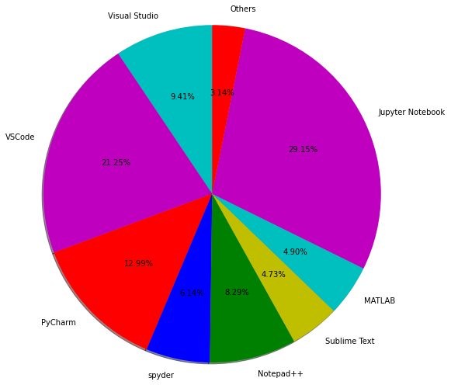
MOST PREFERRED IDEs…

Slide 13
Jupyter Notebook is highly preferred IDE in ML and Data Science learning as it includes different features required to show data in different forms.
VS Code and Pycharm may also be used if not Jupyter Notebook.

Slide 14
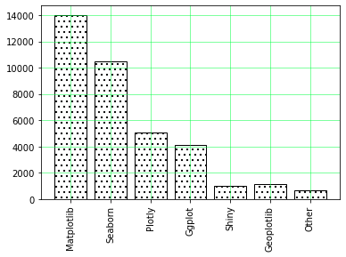
Best data visualization libraries …

Slide 15
Matplotlib is the best data visualization library and is highly preferred.
Matplotlib allows users to create numerous and diverse plot types. It can be used in variety of user interfaces such as python scripts, jupyter notebooks as well as web applications.

Slide 16
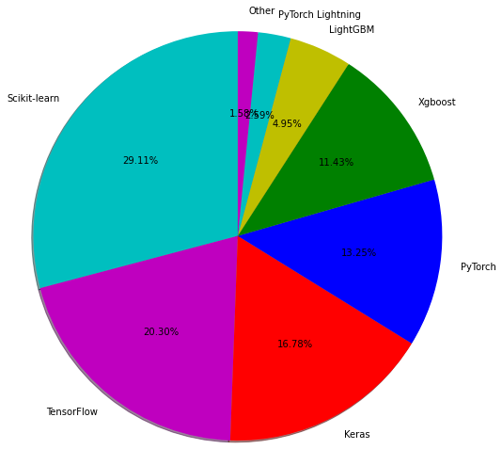
Best Machine learning Frameworks

Slide 17
Scikit-Learn is the most useful and robust library for machine learning in python and is highly preferred.
TensorFlow is an open-source library developed by Google primarily for deep learning applications.

Slide 18
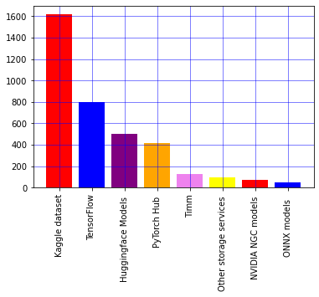
Best ml model hubs/repositories

Slide 19
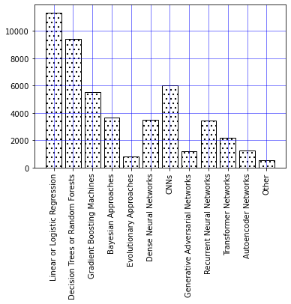
HIGHLY USED ML ALGORITHMS…

Slide 20
As seen from the graph it can be said that Linear or Logistic Regression is the most frequently used ML algorithm.
After that decision trees or random forests are also highly used in different fields of ML .
So a beginner should first more focus on the basic understanding of these algorithms that will help them in future to hold a grasp in this field.

Slide 21
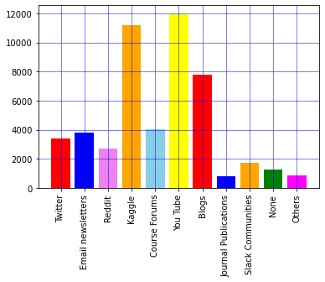
Favorite social media sites that report on data science

Slide 22
You tube is the most favourite social media site that report on data science so it should be followed.
Nextly Kaggle is also one of the favourite sites among ML and data science community. It allows users to collaborate with other users ,find and publish datasets and compete with other data scientists to solve data science challenges.
Blogs can also be followed.

Slide 23
Key points to be followed
From all these discussion to begin or staying in the field of Data Science and ML, it can be concluded that one should prefer a Coursera course in beginning to grasp some basics.
Python should be selected as the programming language.
Jupyter Notebook should be choosed over other IDEs.
Different video platforms should be used in positive learning.
Algorithms like Linear and Logistic regression should be learnt in deep detail .
Libraries like Matplotlib ,Scikit Learn should be more focussed.
Platforms like Kaggle should be used to practice different ML algorithms on real time datasets.

Slide 24
thank you

